Slide 1


ONLINE MOBILE RECHARGE
BY
-Shriram -Ranganithilesh R -Lakshman

Slide 2
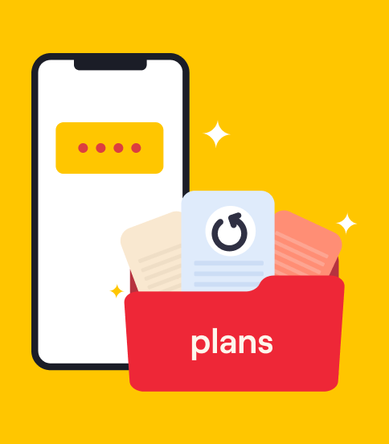
About the Project
The Online Mobile Recharge Portal is a web-based application designed to facilitate seamless and efficient mobile recharge services. This portal allows users to recharge their mobile phones online with ease and convenience, ensuring a smooth and user-friendly experience.

Slide 3
ABOUT THE PROJECT
Key Features
Technology Stack
Components
1) User Registration and Login 2) Recharge Options 3) Transaction History 4) Profile Management 5) Responsive Design
1)Frontend 2)State Management 3)Routing 4)Styling
1)Navbar 2)Home 3)History 4)Signup & Login 5)Dashboard 6)Profile 7)MobileRechargeForm

Slide 4
Project statement
OBJECTIVE
To develop a secure, efficient, and user-friendly online platform that enables users to recharge their mobile phones seamlessly, providing a superior user experience and addressing the limitations of traditional and existing online recharge methods.

Slide 5
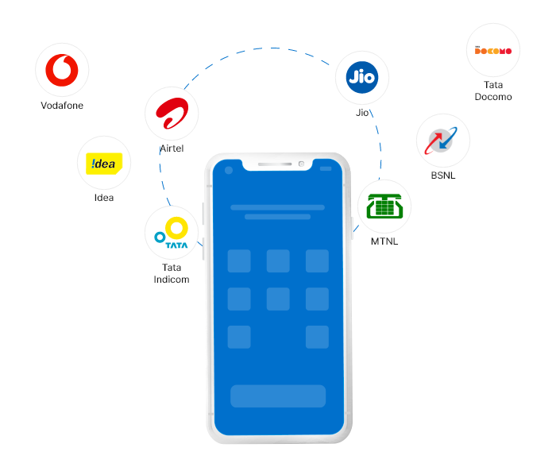
Scope
1) User Registration and Login:
*Implement secure user authentication and authorization mechanisms.
*Allow users to register, log in, and manage their accounts.
2) Mobile Recharge Functionality:
*Provide a variety of mobile recharge options for different carriers and plans. *Ensure a simple and intuitive recharge process with real-time updates.

Slide 6
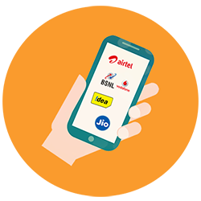
3) Transaction History: *Enable users to view and manage their past recharge transactions.
*Provide detailed information on each transaction, including date, amount, and status.
4) Profile Management: : *Allow users to update their personal information, such as contact details and payment preferences.
*Ensure data is stored securely and can be easily accessed and modified by the user.

Slide 7

5) Security:
*Implement robust security measures to protect user data and transactions.
*Ensure compliance with industry standards for data protection and privacy.

Slide 8
6) User Dashboard:
7) Responsive Design:
*Provide a comprehensive dashboard for users to view key information and perform quick actions. *Include features like quick recharge options, balance inquiry, and promotional offers.
* Develop a responsive interface that works seamlessly across desktops, tablets, and smartphones. *Ensure consistent performance and user experience across all devices.

Slide 9
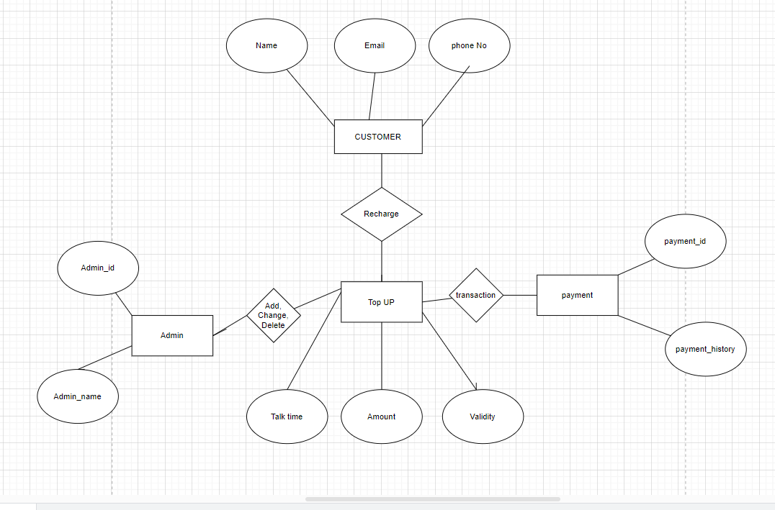
ER-DIAGRAM

Slide 10
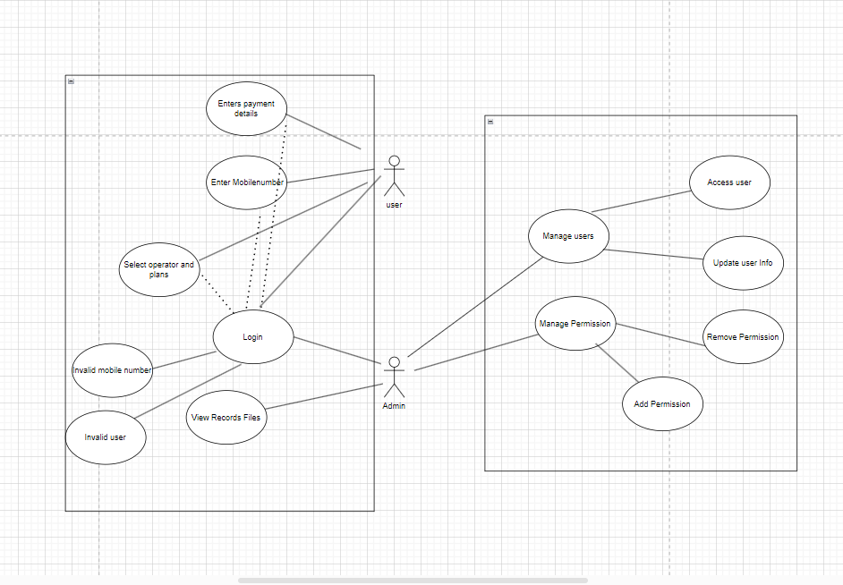
USECASE-DIAGRAM

